Slide 1
Two-level Exact Boolean Function Minimization

Slide 2
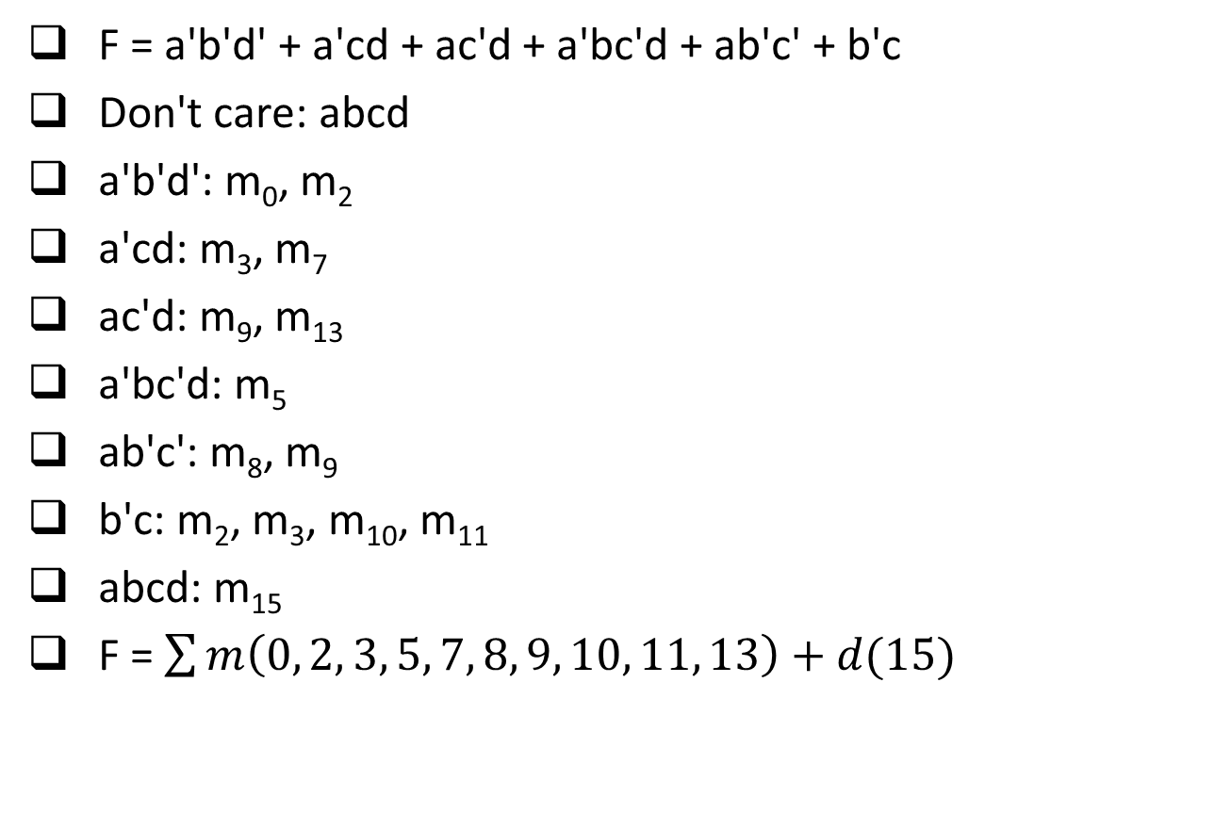
Quine-McClusky Algorithm
F = a'b'd' + a'cd + ac'd + a'bc'd + ab'c' + b'c
Don't care: abcd
a'b'd':
a'cd:
ac'd:
a'bc'd:
ab'c':
b'c:
abcd:
F = a'b'd' + a'cd + ac'd + a'bc'd + ab'c' + b'c
Don't care: abcd
a'b'd': m₀, m₂
a'cd: m₃, m₇
ac'd: m₉, m₁₃
a'bc'd: m₅
ab'c': m₈, m₉
b'c: m₂, m₃, m₁₀, m₁₁
abcd: m₁₅
F = $\sum{m\left(0, 2, 3, 5, 7, 8, 9, 10, 11, 13\right)+d(15)}$

Slide 3
Prime Implicant (PI) Generation
Group | Minterm | 4-literal | Minterms | 3-literal | Minterms | 2-literal
0 | m₀ | 0000 | m₀, m₂ | 00-0 | m₀, m₂, m₈, m₁₀ | -0-0
 |  |  | m₀, m₈ | -000
1 | m₂ | 0010 | m₂, m₃ | 001- | m₂, m₃, m₁₀, m₁₁ | -01-
 |  |  | m₂, m₁₀ | -010
 | m₈ | 1000 | m₈, m₉ | 100- | m₈, m₉, m₁₀, m₁₁ | 10--
 |  |  | m₈, m₁₀ | 10-0
2 | m₃ | 0011 | m₃, m₇ | 0-11 | m₃, m₇, m₁₁, m₁₅ | --11
 |  |  | m₃, m₁₁ | -011
 | m₅ | 0101 | m₅, m₇ | 01-1 | m₅, m₇, m₁₃, m₁₅ | -1-1
 |  |  | m₅, m₁₃ | -101
 | m₉ | 1001 | m₉, m₁₁ | 10-1 | m₉, m₁₁, m₁₃, m₁₅ | 1--1
 |  |  | m₉, m₁₃ | 1-01
 | m₁₀ | 1010 | m₁₀, m₁₁ | 101-
3 | m₇ | 0111 | m₇, m₁₅ | -111
 | m₁₁ | 1011 | m₁₁, m₁₅ | 1-11
 | m₁₃ | 1101 | m₁₃, m₁₅ | 11-1
4 | m₁₅ | 1111
✓
✓
✓
✓
✓
✓
✓
✓
✓
✓
✓
✓
✓
✓
✓
✓
✓
✓
✓
✓
✓
✓
✓
✓
✓
✓
✓

Slide 4
Essential PI Identification
Symbol | Notation | Product term | m₀ | m₂ | m₃ | m₅ | m₇ | m₈ | m₉ | m₁₀ | m₁₁ | m₁₃
U | -0-0 | b'd' | ✓ | ✓ |  |  |  | ✓ |  | ✓
V | -01- | b'c |  | ✓ | ✓ |  |  |  |  | ✓ | ✓
W | 10-- | ab' |  |  |  |  |  | ✓ | ✓ | ✓ | ✓
X | --11 | cd |  |  | ✓ |  | ✓ |  |  |  | ✓
Y | -1-1 | bd |  |  |  | ✓ | ✓ |  |  |  |  | ✓
Z | 1--1 | ad |  |  |  |  |  |  | ✓ |  | ✓ | ✓
Essential prime implicant (EPI): b'd', bd (∵ m₀, m₅ is covered by only one PI)

Slide 5
Petrick's Method
Symbol | Notation | Product term | m₃ | m₉ | m₁₁
V | -01- | b'c | ✓ |  | ✓
W | 10-- | ab' |  | ✓ | ✓
X | --11 | cd | ✓ |  | ✓
Z | 1--1 | ad |  | ✓ | ✓
(V + X) (W + Z) (V + W + X + Z)
= (VW + VZ + WX + XZ) (V + W + X + Z)
= VW + VWX + VWZ + VZ + VXZ + WX + WXZ + XZ
∴ VW, VZ, WX, XZ are best solutions (i.e., minimum number of product terms)
F = b'd' + bd + b'c + ab' = b'd' + bd + b'c + ad = b'd' + bd + ab' + cd = b'd' + bd + cd + ad

